Slide 1
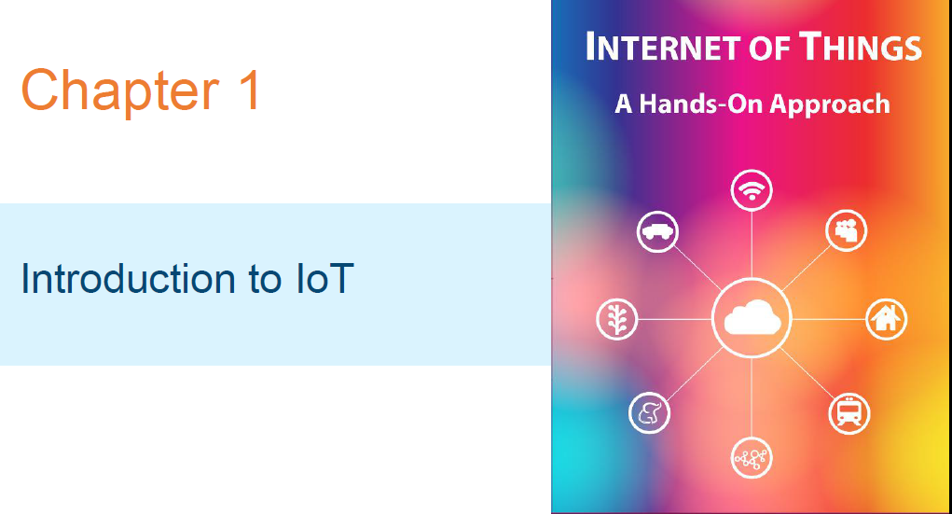

Slide 2
Course Information
Course Code: ISEC2
Credit: 4:0:0:0
Prerequisite: Internet of Things Course Coordinator: Ashwitha A
Contact Hours: 56L

Slide 3
Course Outcomes (COs):
At the end of the course, students will be able to
1. Explain different design issues and domains of IoT. (PO-1,2,9,10,12) (PSO-1)
2. Identify different design methodologies and end point devices of IoT. (PO-1,2.4,5,10,12) (PSO-1,2)
3. Distinguish different cloud based solution for IoT. (PO-1,3,10,12) ( PSO-1,2)
4. Understand different case studies related to IoT framework. (PO1,2,,5,10,12) ( PSO-1,2)
5. Solve data analytical problems on IoT. ( PO-1,2,5) (PSO- 1,3)

Slide 4
Text Book Information
Prescribed Text Book
Internet of Things (A Hands-on-Approach) by Arshdeep Bagha ,Vijay Madisetti University press 2015.
Reference Text Book
Enterprise IoT: Strategies and Best Practices for Connected Products and Services By Dirk Slama, Frank Puhlmann, Jim Morrish, Rishi M Bhatnagar

Slide 5
Unit-1 Outline
• IoT definition
• Characteristics of IoT
• Physical Design of IoT
• Logical Design of IoT
• IoT Protocols
• IoT Levels & Deployment Templates

Slide 6
Definition of IoT
A dynamic global network infrastructure with self-configuring capabilities based on standard and interoperable communication protocols where physical and virtual "things" have identities, physical attributes, and virtual personalities and use intelligent interfaces, and are seamlessly integrated into the information network, often communicate data associated with users and their environments.

Slide 7
Characteristics of IoT
• Dynamic & Self-Adapting
• Self-Configuring
• Interoperable Communication Protocols
• Unique Identity
• Integrated into Information Network

Slide 8
Physical Design of IoT
• The "Things" in IoT usually refers to IoT devices which have unique identities and can perform remote sensing, actuating and monitoring capabilities.
• IoT devices can:
• Exchange data with other connected devices and applications (directly or indirectly), or
• Collect data from other devices and process the data locally or Send the data to centralized servers or cloud-based application back-ends for processing the data, or
• Perform some tasks locally and other tasks within the IoT infrastructure, based on temporal and space constraints

Slide 9
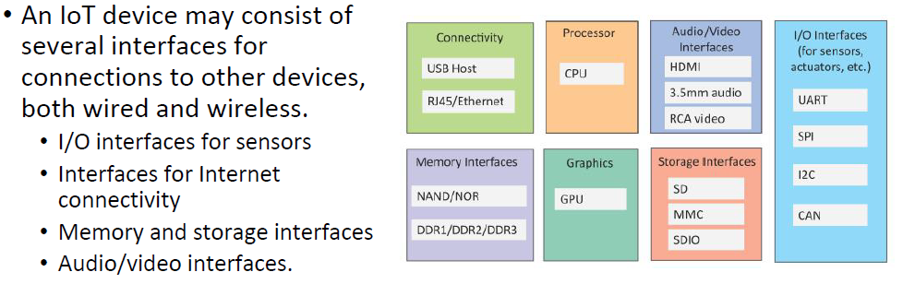
Generic block diagram of an IoT Device

Slide 10
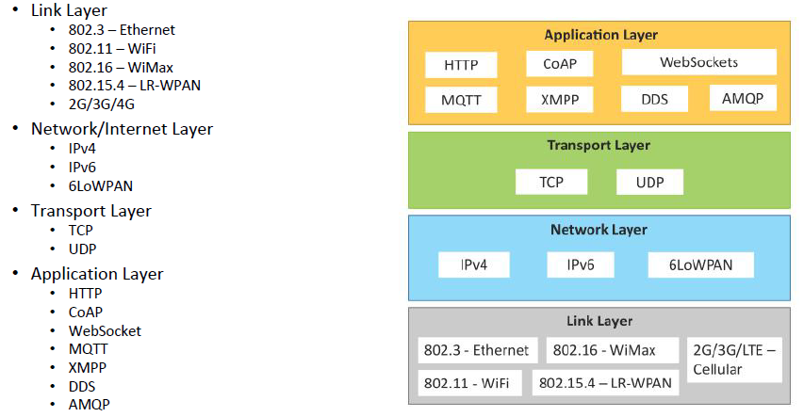
IoT Protocols

Slide 11
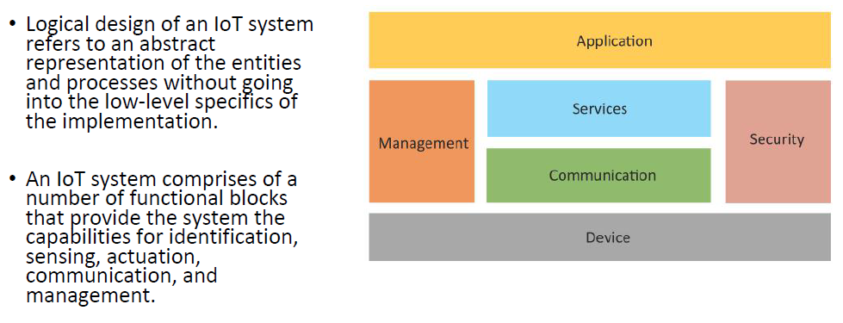
Logical Design of IoT

Slide 12
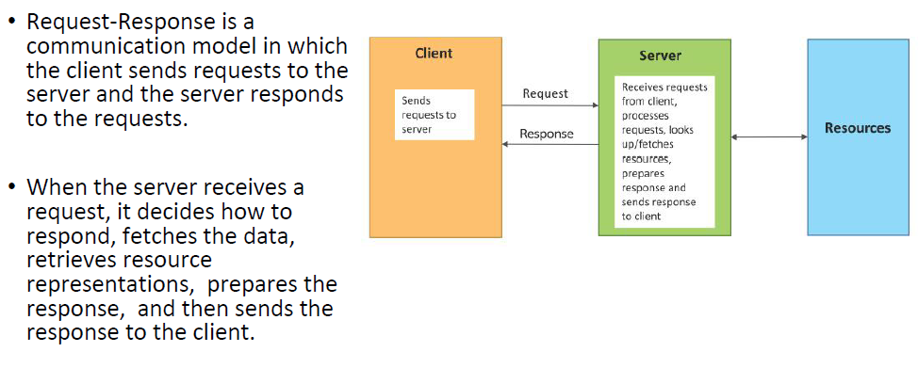
Request-Response communication model

Slide 13
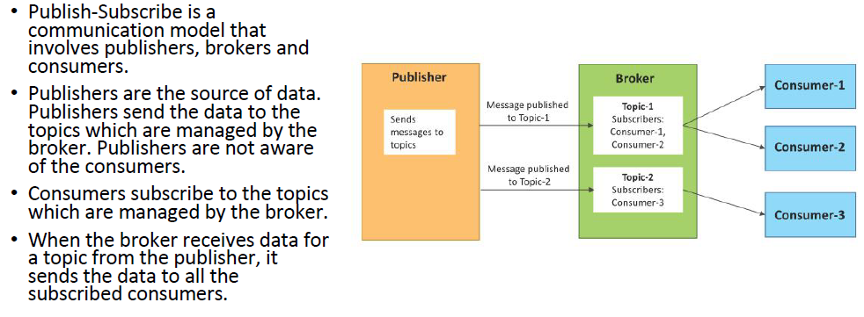
Publish-Subscribe communication model

Slide 14
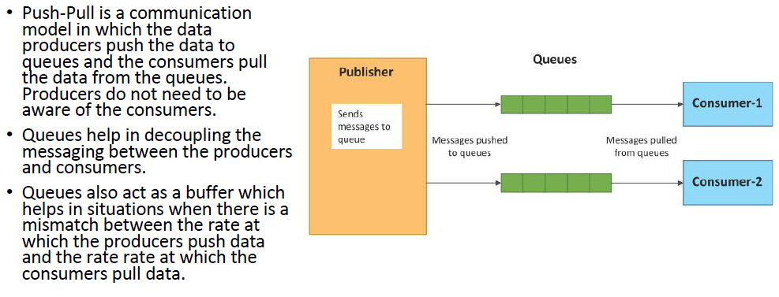
Push-Pull communication model

Slide 15
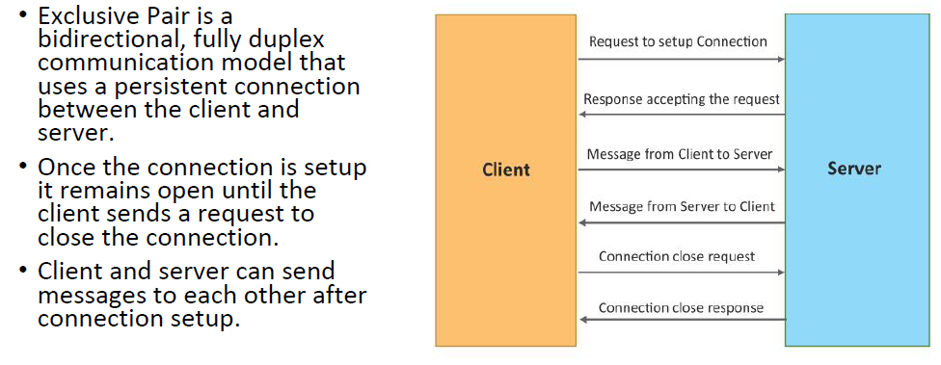
Exclusive Pair communication model

Slide 16
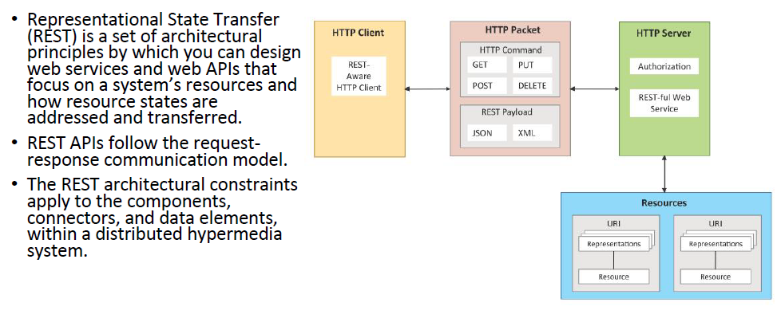
REST-based Communication APIs

Slide 17
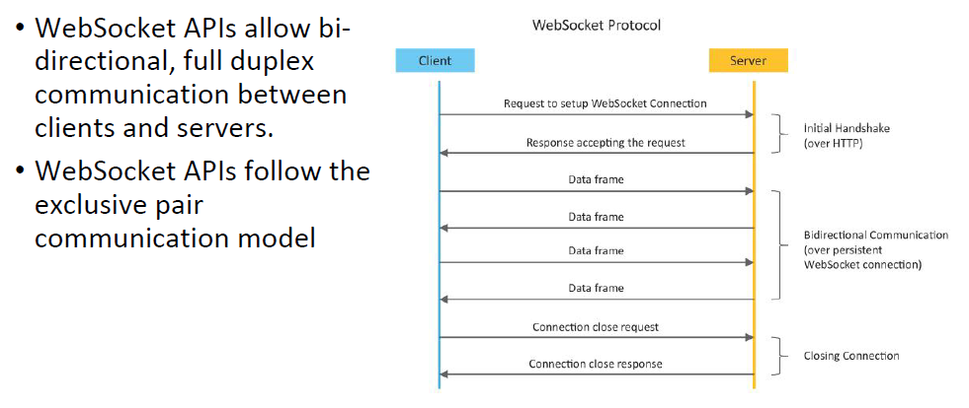
WebSocket-based Communication APIs

Slide 18
HTTP | Resource Type | Action | Examples
GET | COLLECTION URI | List all the resource in the Collection | http://example.com/api/tasks (list all the tasks)
GET | Element URI | Get information about resource | http://example.com/api/tasks/1/(Get Information on task-1)
POST | COLLECTION URI | Create a new resource | http://example.com/api/tasks (Create a new task from data provided in the request)
POST | Element URI | Generally not used
PUT | COLLECTION URI | Replace the entire collection with another collection | http://example.com/api/tasks/1/ (Replace Entire collection data provided in the request)
PUT | Element URI | Update the Resource | http://example.com/api/tasks/1/ (Update task-1 withdata provided in the request)
DELETE | COLLECTION URI | Delete entire collection | http://example.com/api/tasks (delete all tasks)
DELETE | Element URI | Delete resource | http://example.com/api/tasks/1/ (delete task-1)
Notes:
HTTP REQUEST Methods and Actions

Slide 19
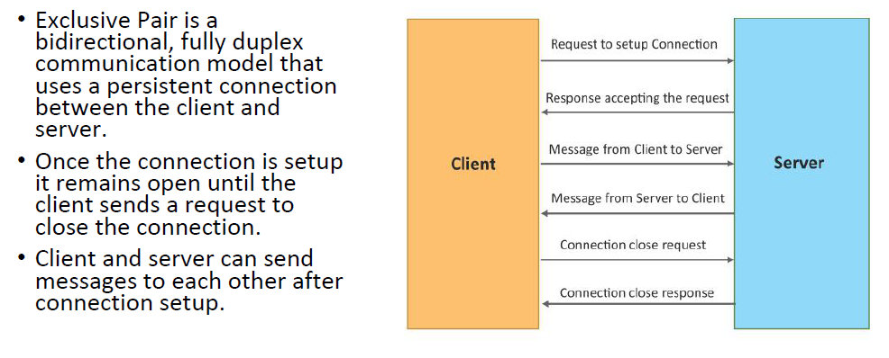
Exclusive Pair communication model

Slide 20
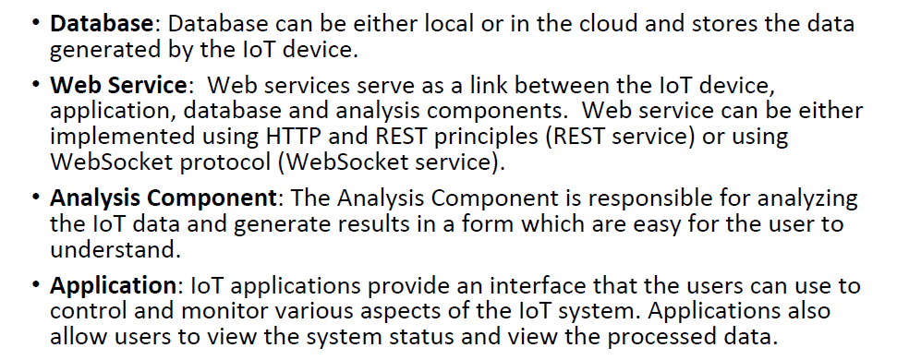
IoT Levels & Deployment Templates

Slide 21
Iot Enabling Technologies
1.Wireless Sensor Networks
2.Cloud Computing
3.Big Data Analytics
4.Communication protocols
5.Embedded Systems

Slide 22
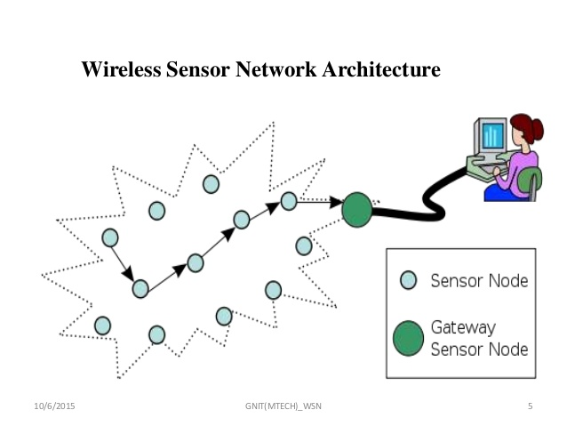
WSN contains number of end nodes and routers and coordinators

Slide 23
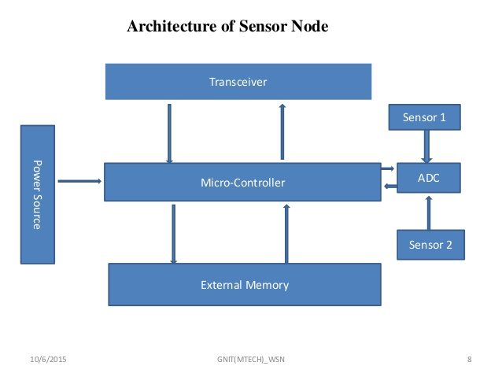
Wireless Sensor Networks(WSN)

Slide 24
2.Cloud Computing(CC)
It is a transformative computing paradigm involves delivering applications and services over the Internet.
Services of CC
Infrastructure as a service(IaaS)
Platform as a service(PaaS)
Software as a service(SaaS)

Slide 25
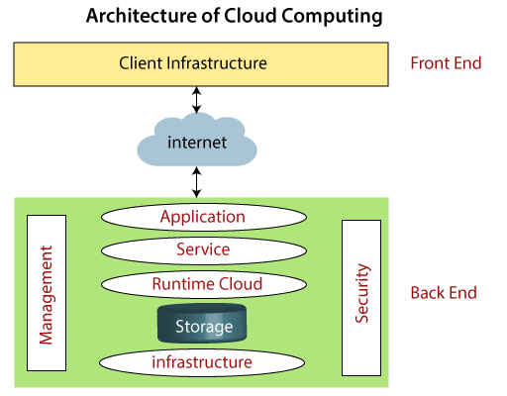
2.Cloud Computing(CC)

Slide 26
3.Big Data Analytics(BDA)
It is defined as collection of data sets whose volume, velocity or variety is large that it is difficult to store,manage,process and analyze the data using traditional databases and data processing tools.
CHARECTERISTICS:
Volume
Velocity
Variety

Slide 27
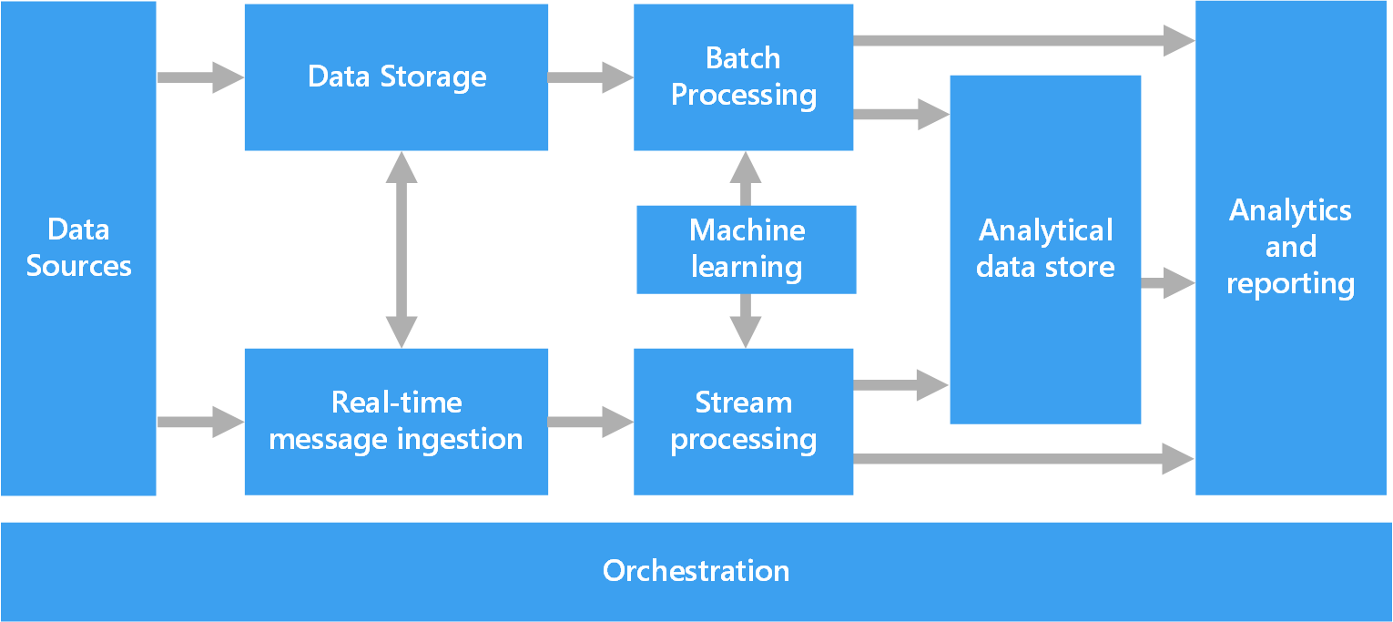
BDA ARCHITECTURE

Slide 28
4.Communication Protocols
Data exchange Formats
Data Encoding
Addressing schemes for devices
Routing Packets
Sequence Control
Flow control
Retransmission of lost packets

Slide 29
Embedded System
Is a computer system has computer hardware and software embedded to perform some specific tasks.
ey components
Microprocessor or microcontroller
Memory
Networking units
Input/output units
Storage

Slide 30
IOT Deployment Templates
Components
Device
Resource
Controller Service
Database
Web Service
Stateless/Statefull
Unidirectional/Bidirectional
Request-Response/Full Duplex
Tcp Connections
Header Overhead
Scalability
Analysis component
Application

Slide 31
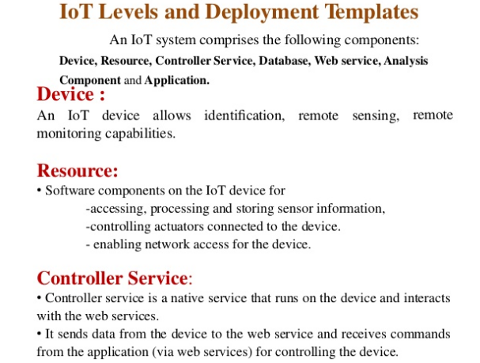

Slide 32
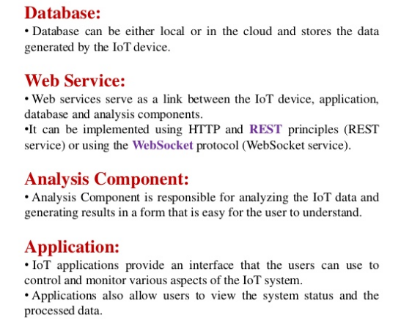

Slide 33
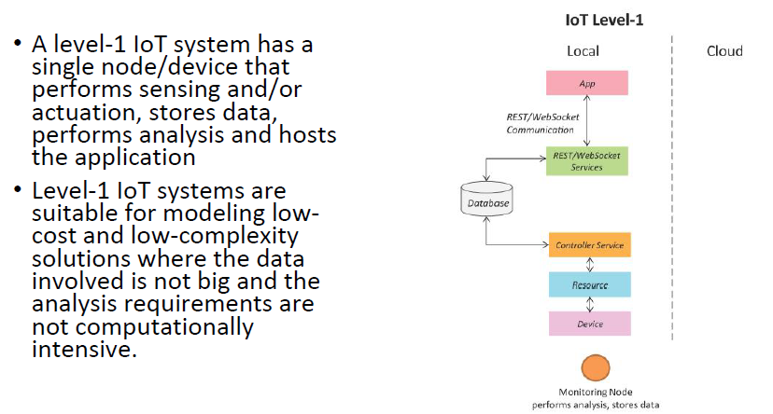
IoT Level-1

Slide 34
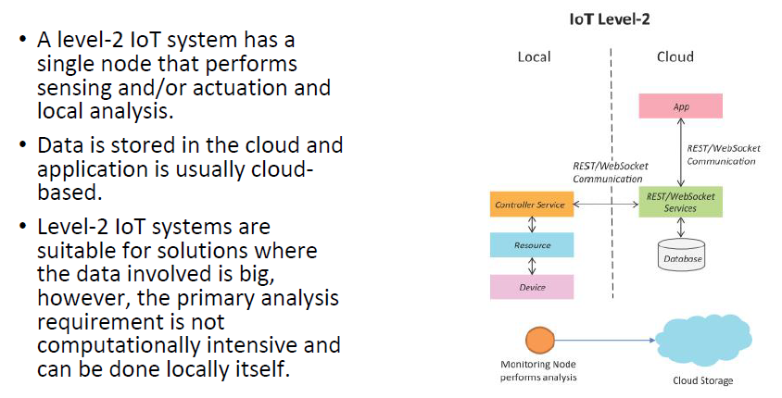
IoT Level-2

Slide 35
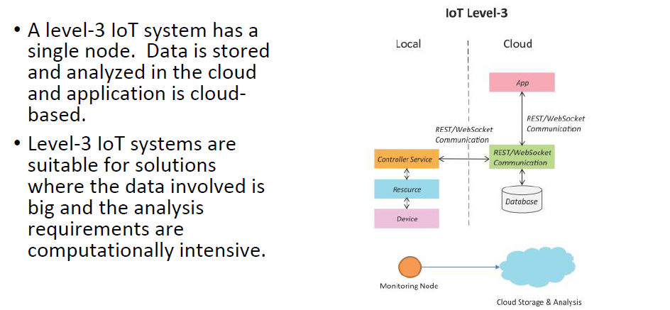
IoT Level-3

Slide 36
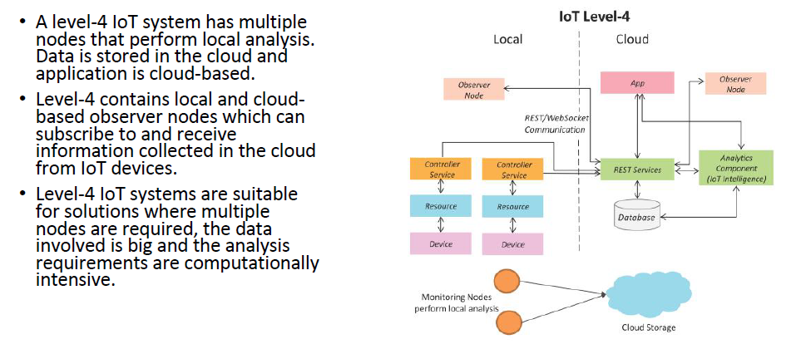
IoT Level-4

Slide 37
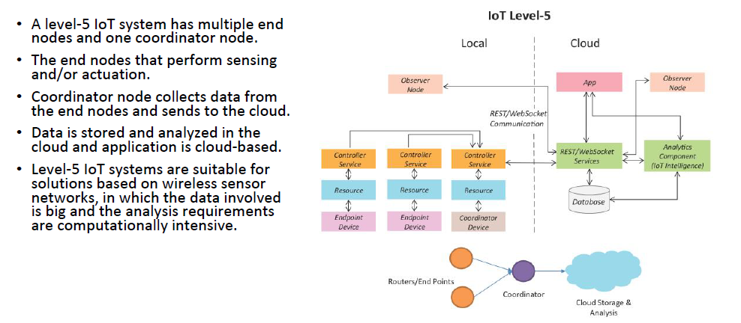
IoT Level-5

Slide 38
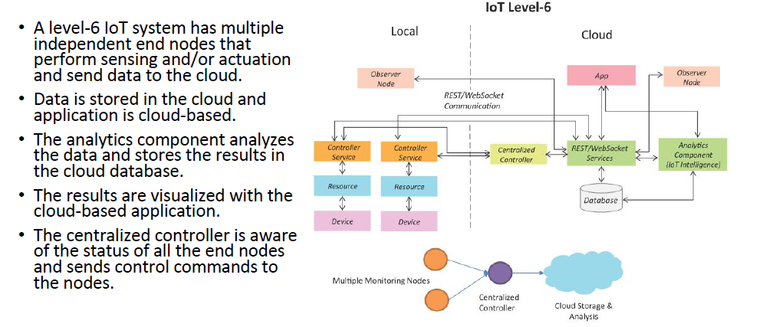
IoT Level-6

Slide 39
QUIZ
1.MQTT stands for _____________ a) MQ Telemetry Things b) MQ Transport Telemetry c) MQ Transport Things d) MQ Telemetry Transport
2.A sensor uses which network? a) LAN and HAN b) HAN and PAN c) LAN and PAN d) LAN, PAN and HAN
3. CoAP is designed for use between devices on the same constrained network. a) True b) False
4. Which layer is CoAP? a) Control layer b) Transport layer c) Service layer d) Application layer

Slide 40
QUIZ
5.CoAP provides which of the following requirements? a) Multicast support and simplicity b) Low overhead and multicast support c) Simplicity and low overhead d) Multicast support, Low over head, and simplicity
6. Do CoAP has memory? a) True b) False
7. CoAP does not provide any security. a) True b) False
8. Which protocol is lightweight? a) MQTT b) HTTP c) CoAP d) SPI

Slide 41
QUIZ ANSWERS
1.Answer:d Explanation: MQTT was known as MQ Telemetry Transport protocol. MQTT is a lightweight protocol that runs on top of the TCP/IP protocol.
2.Answer:d Explanation: Sensors usually have very limited capability in terms of networking connection. Your sensors can likely utilize Bluetooth networking connectivity. The protocols like LAN, HAN and PAN has a common they can directly connect to large networks like WAN or Internet.
3.Answer:a Explanation: CoAP is designed for use between devices on the same constrained network (e.g., low-power, lossy networks), between devices and general nodes on the internet, and between devices on different constrained networks both joined by an internet.
4.Answer:c Explanation: In intelligent network and cellular network, service layer is a conceptual layer within a network service provider architecture. CoAP is a service layer protocol that is intended for use in resource-constrained internet devices, such as wireless sensor network nodes.

Slide 42
5. Answer: d Explanation: Multicast, low overhead, and simplicity are extremely important for Internet of Things (IoT) and Machine-to-Machine (M2M) devices, which tend to be deeply embedded and have much less memory and power supply than traditional internet devices have.
6. Answer: a Explanation: The nodes have 8-bit microcontrollers with small amount of ROM and RAM, while constrained network such as IPv6 over Low-power Wireless Personal Area Network often high packet error rates and a typical throughput of 10s of kbit/s.
7. Answer: b Explanation: The Internet of Things cannot spread as long as it can be exploited by hackers willy-nilly. CoAP does not just pay lip service to security, it actually provides strong security. CoAP’s default choice of DTLS parameters is equivalent to 3072-bit RSA keys, yet still runs fine on the smallest nodes.
8. Answer: a Explanation: MQTT is a lightweight protocol that runs on top of the TCP/IP protocol and works with publish subscribe mechanism.

Slide 43
THANK YOU

